Slide 1
Ra
Android version of the boardgame
By Benjamin Sklar

Slide 2
Ra
3-5 player boardgame
Auction based
Players accumulate tiles via auctions and score their tiles at end of each of 3 epochs. Tiles are grouped into various categories.
Game description: http://boardgamegeek.com/boardgame/12/ra
iOS version description: https://videogamegeek.com/videogame/86774/reiner-knizias-ra
Source: https://github.com/brskl/Ra
Video presentation: https://youtu.be/n_CXcqok1U0

Slide 3
Computer versions
iOS version
Desktop version
My Android version
v0.1 – based on class material from Fall Quarter 2016 text based with primary goal to implement game functionality
v0.2 – based on class material from Winter Quarter 2016 primary change is use of graphical elements, other changes include: multiple languages, multiple layouts, etc.
V0.2.1 – improved graphical UI
v0.3 – based on class material from Spring Quarter 2017
v1.0 – commercial version to be released to Google Play Store

Slide 4
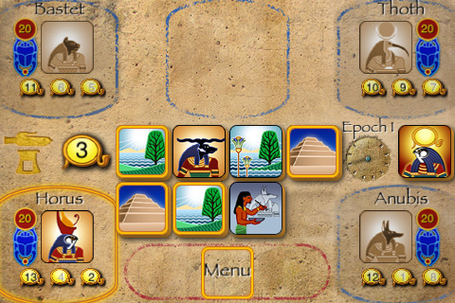
iOS version

Slide 5
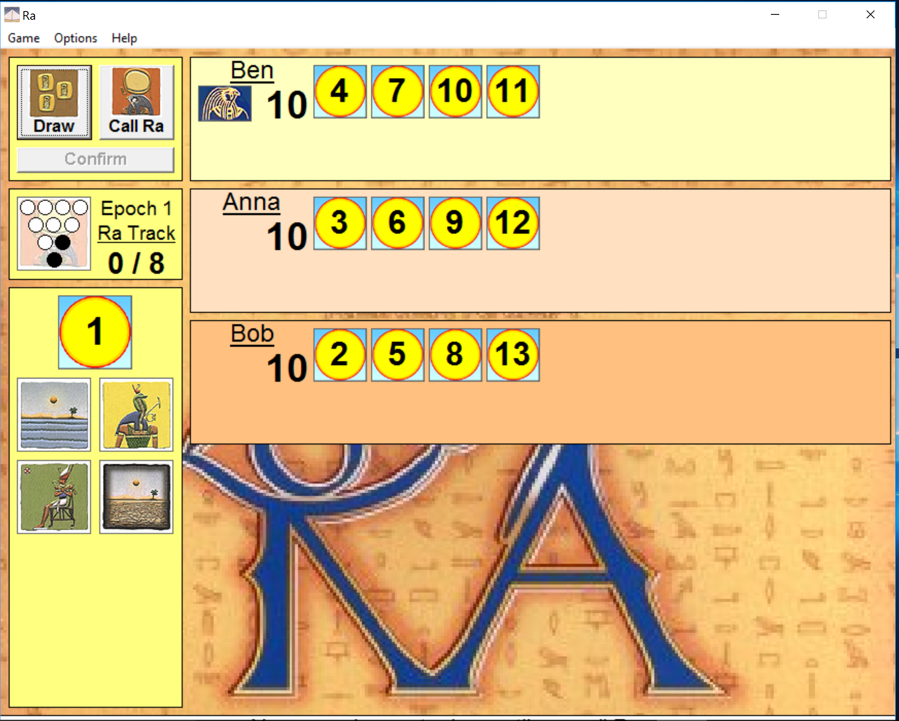
Desktop version
Notes:
Show Ra.exe and do a few moves. Author did it to implement neural network game AI Available at: http://snapper.rooms.cwal.net/games.html

Slide 6
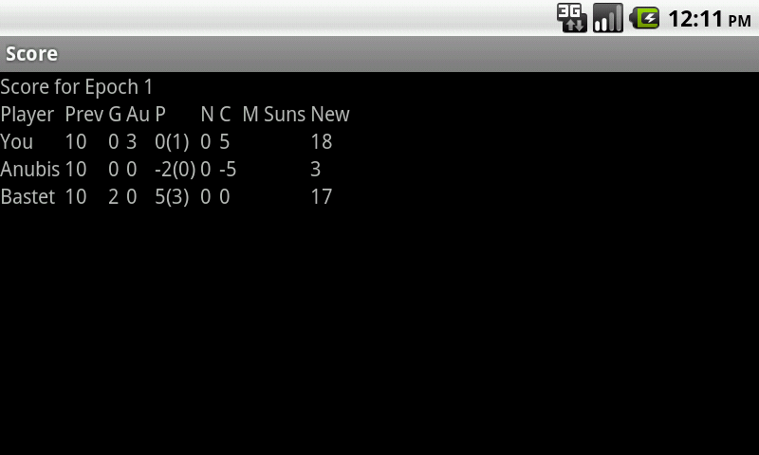
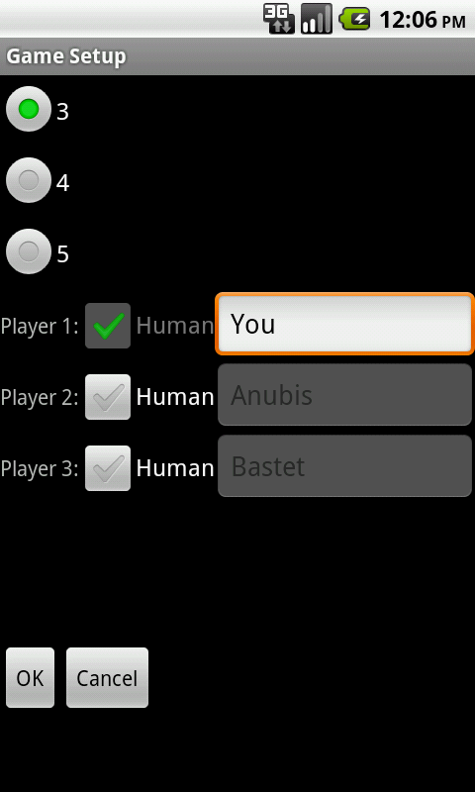
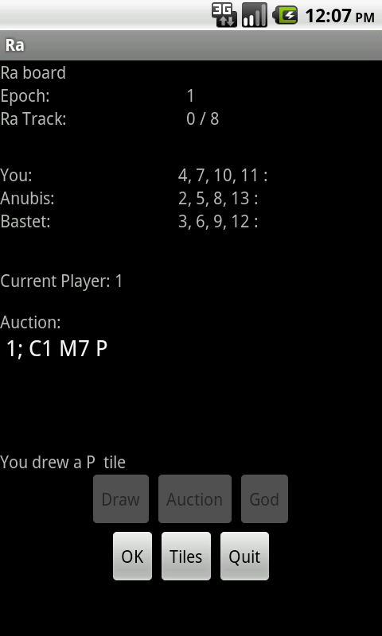
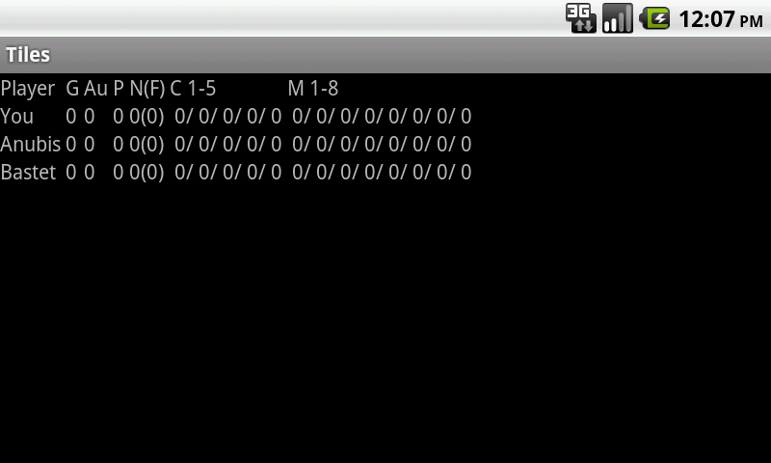
V0.1
Notes:
Textual UI. Primary goal to implement game functionality in working Android app.

Slide 7
V0.2
Main changes
Added graphical elements to GameActivity, ScoreActivity, TilesActivity
Added multiple layouts
Added more strings (plural, localization)
Saving of game-state on GameActivity onStop(), loaded on MainActivity, press ‘Resume’ button.

Slide 8
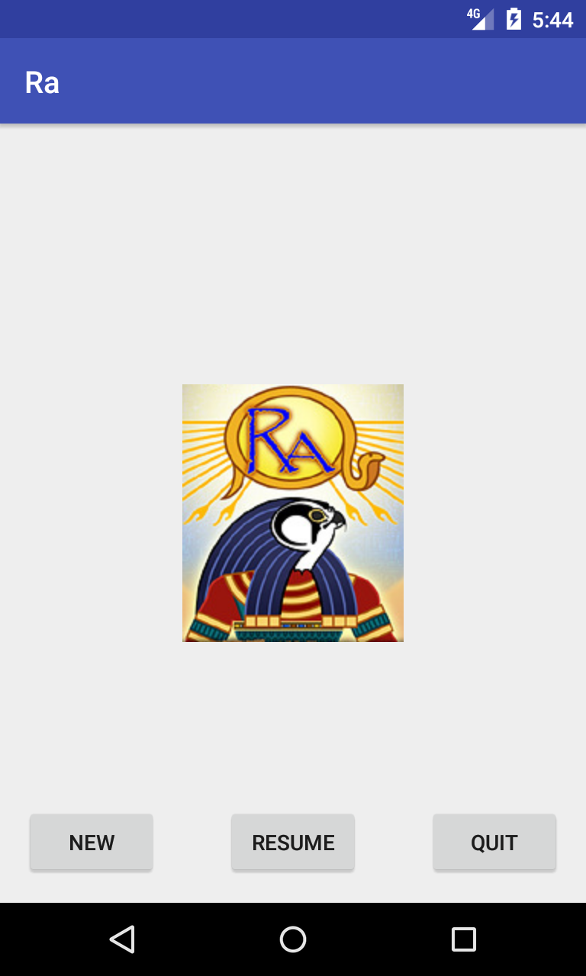
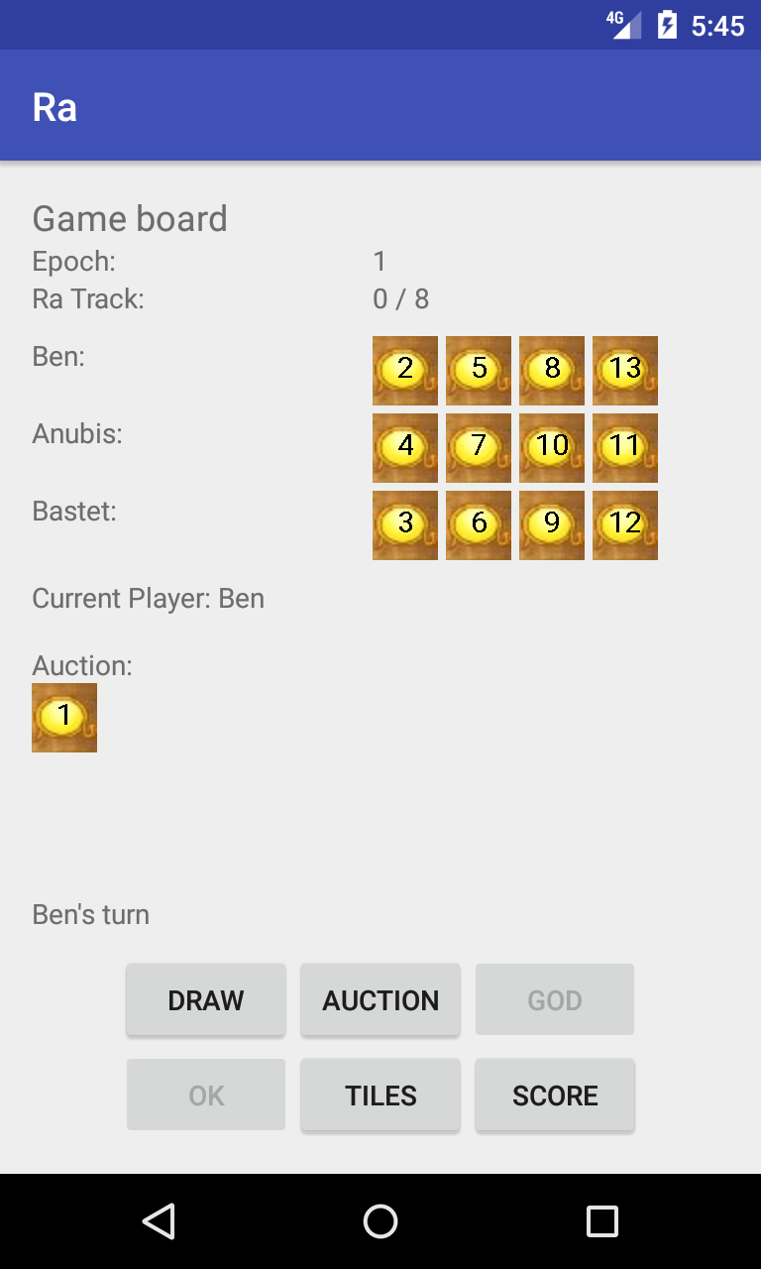
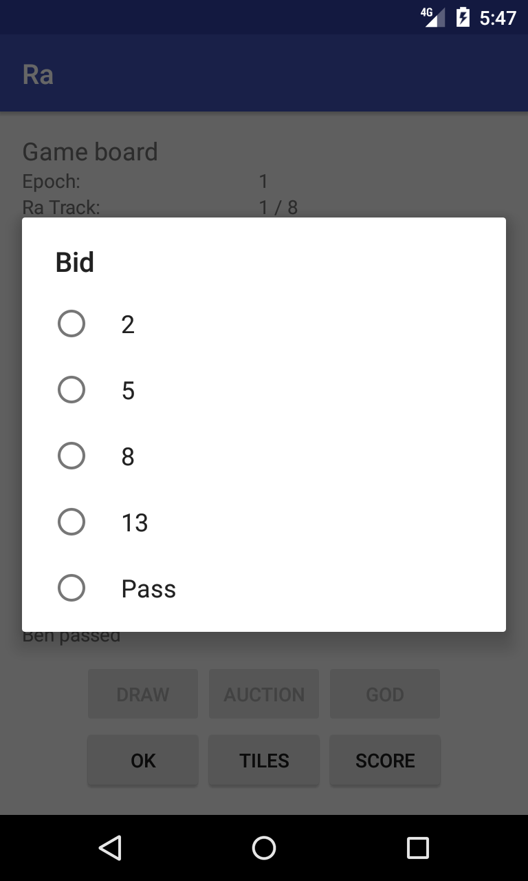
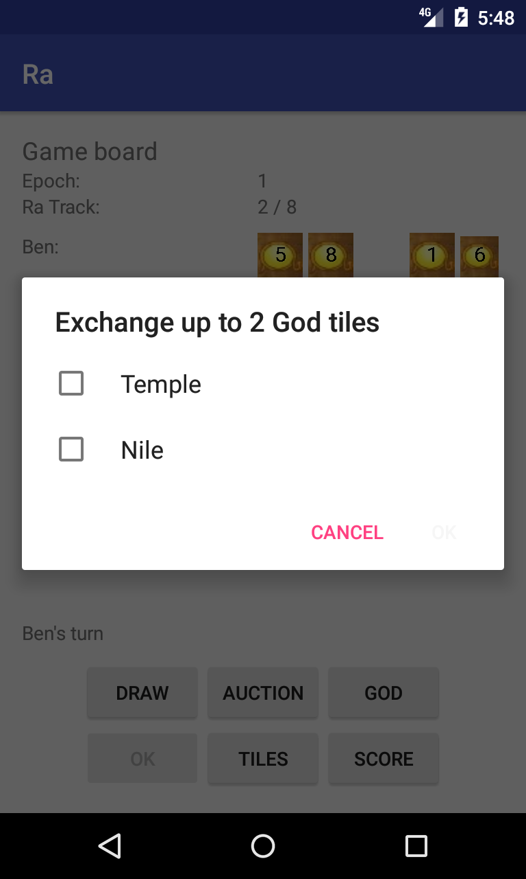
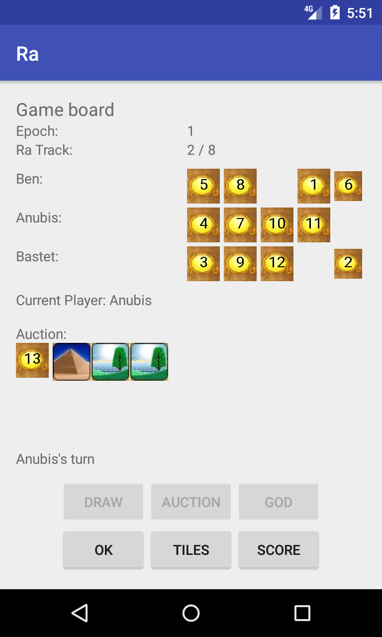
Screenshots

Slide 9
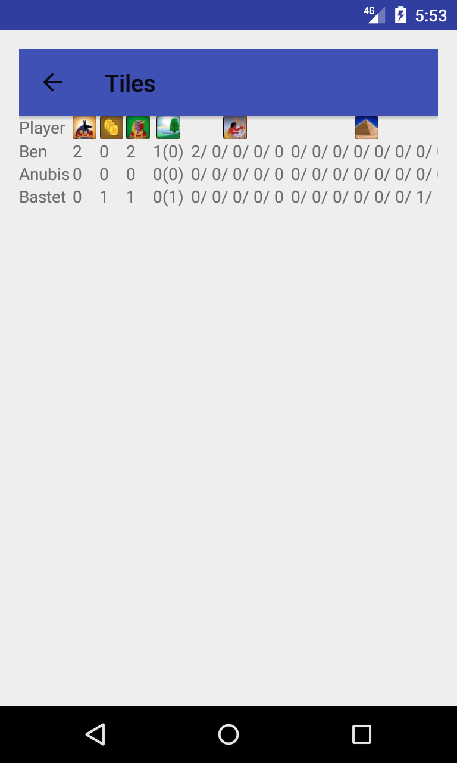
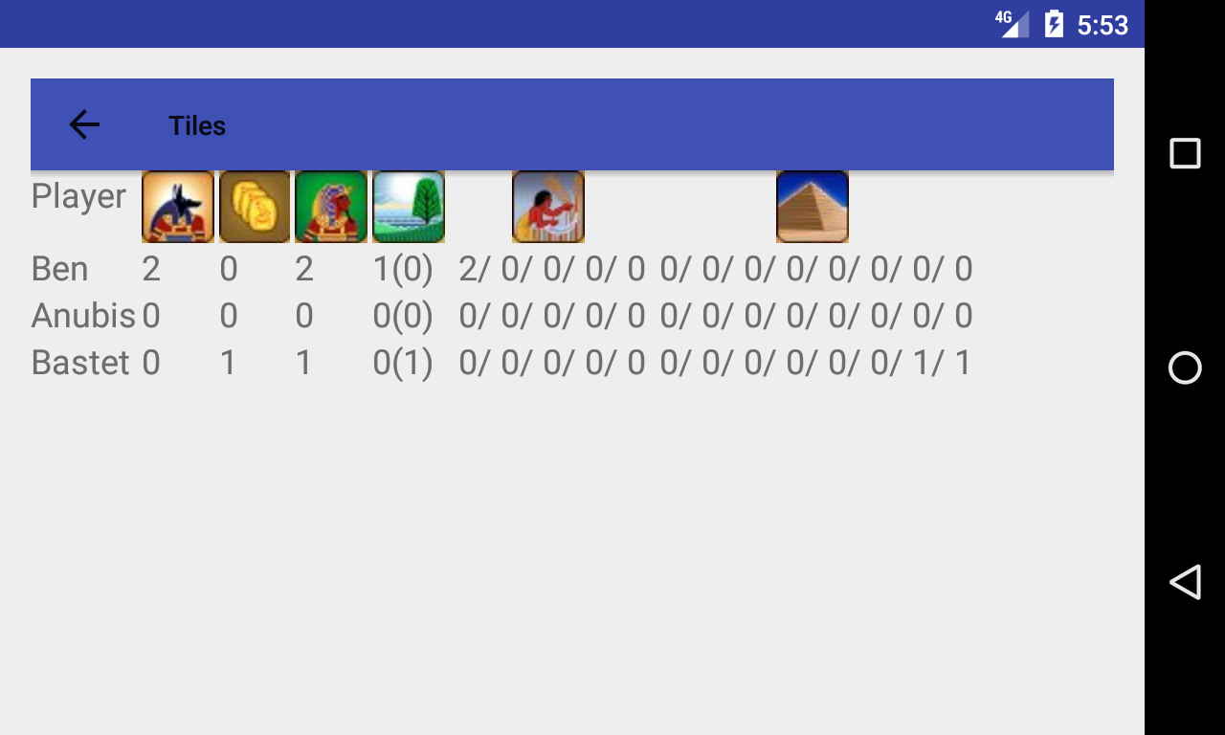
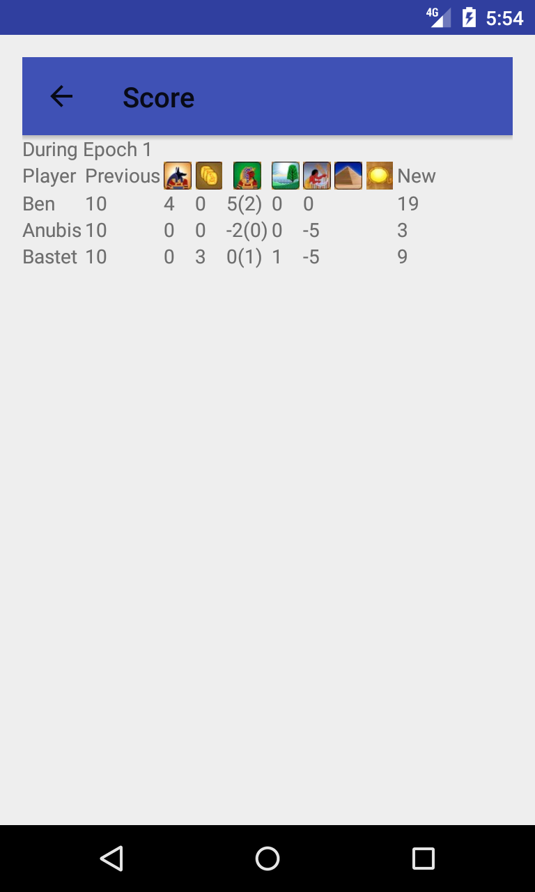
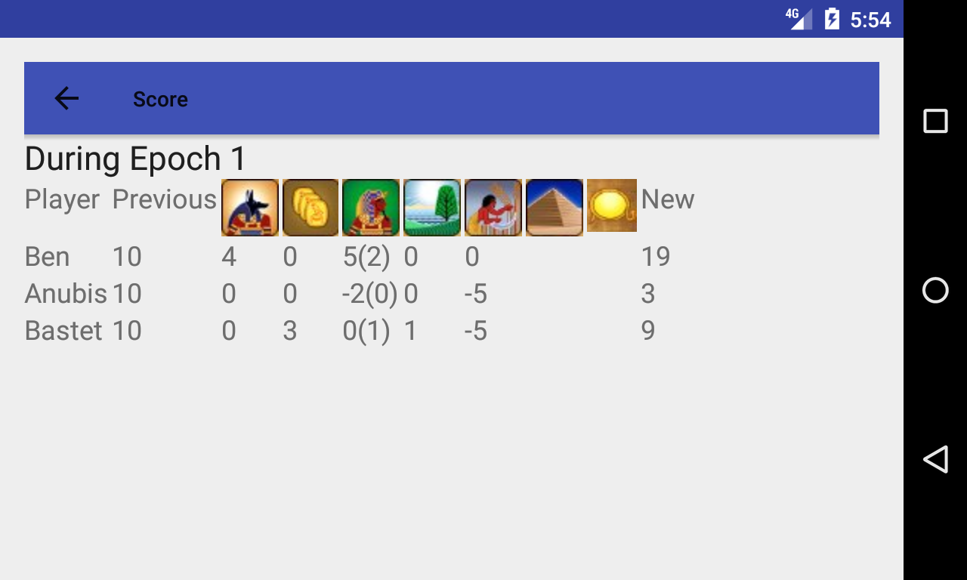
Screenshots

Slide 10
features used
String resources: Plural, multiple languages
New launcher icon w/ multiple resolutions
Animation class used on start-up activity
Multiple Layouts: portrait vs. landscape
‘Up’ navigation
Graphical elements in GameActivity, ScoreActivity, TilesActivity
Saving of game state in internal file
SunImageView subclass of ImageView w/ onDraw to do text numbers over sun-tile graphic

Slide 11
V0.2.1
Main changes
Improved layout
Target phones and tablets using qualifier sw###dp (320, 360, 600, 800)
Have single layout and use dimens.xml to vary layout on sw###dp qualifier
Animation
On Draw Tile, tile moves from tile bag to board location
On winning an auction, tiles move from board to player and fade
Settings activity

Slide 12
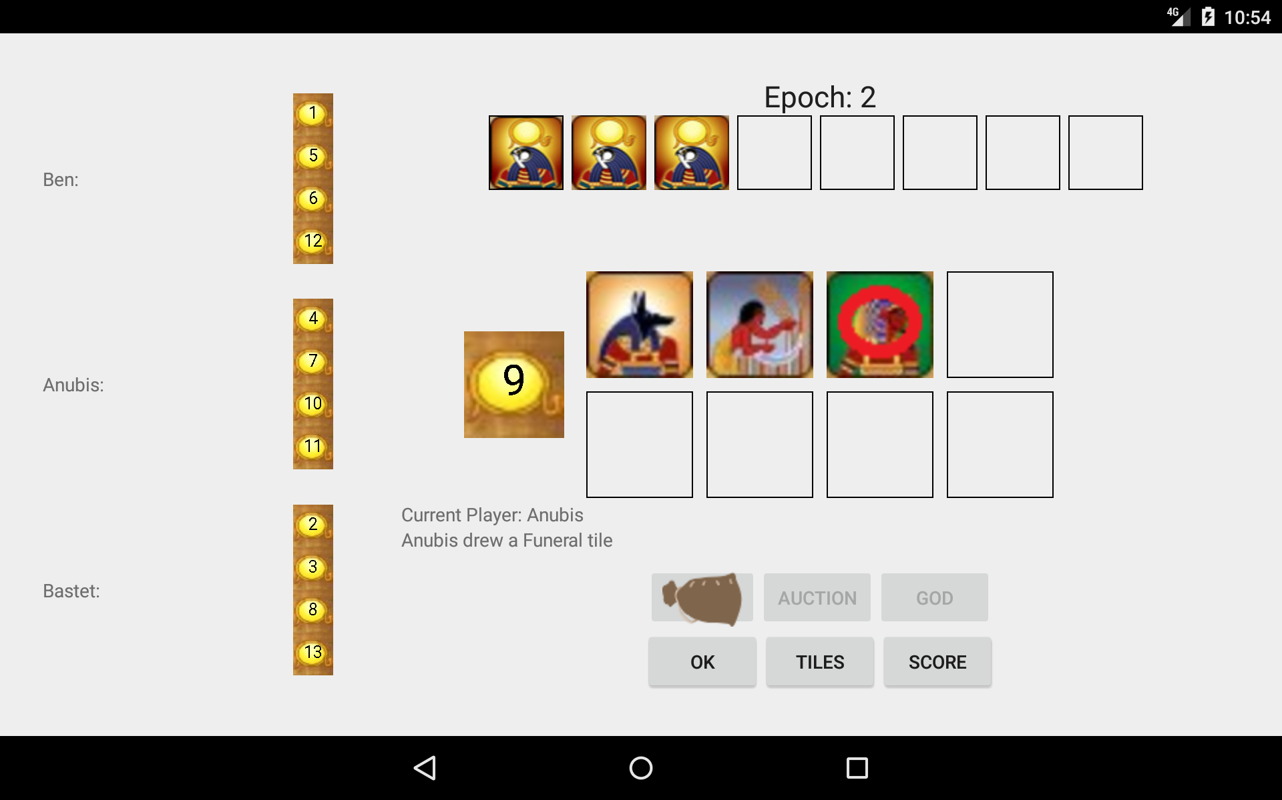
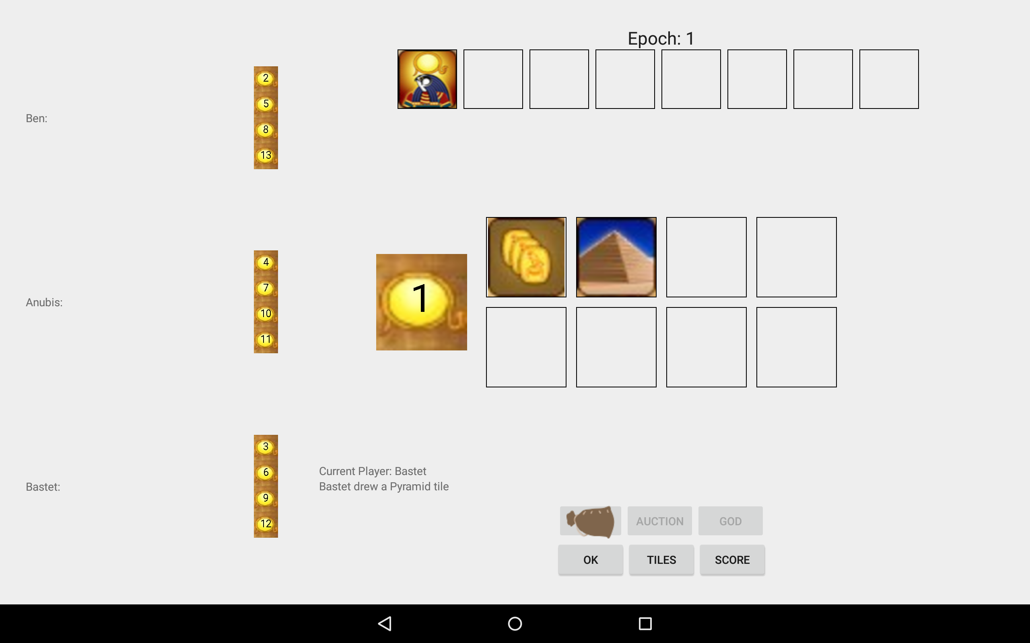
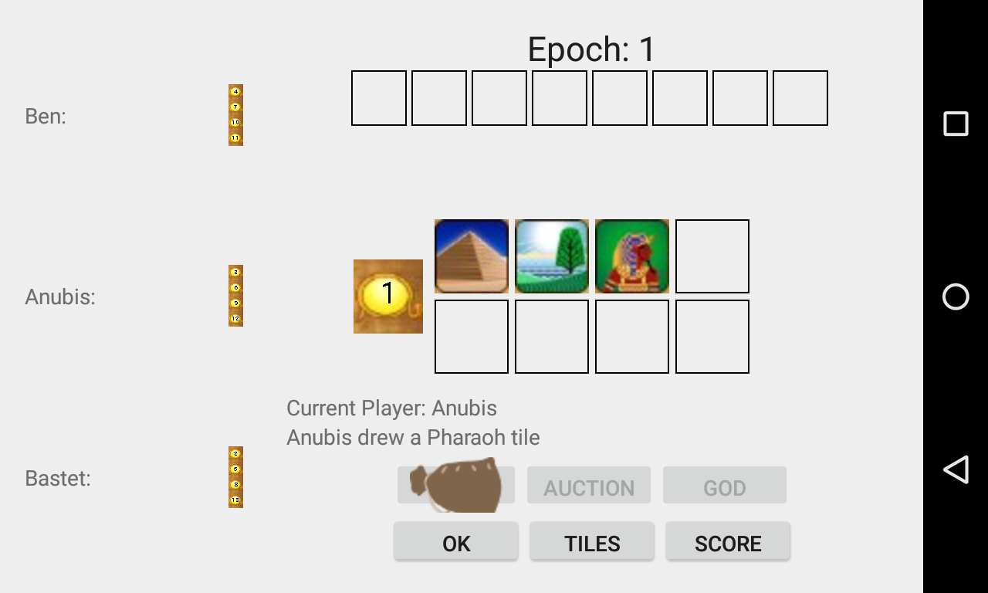
Screenshots

Slide 13
Issues
Animation more difficult than expected
Difficult to combine Scaling and Translation
Difficultly getting AnimationListener to work correctly, particularly when animating multiple tiles.
Need to update static images at correct time

Slide 14
V0.3
Main Changes
Sharing: share final score
AWS, DynamoDB: upload final score

Slide 15
TODO
Animation: improve
Write reasonable AI players
Add networking with other devices for multiple human players (Looking at Google Play Game Services, which includes features for matchmaking and turn-based games)

Slide 16
Links
Source: https://github.com/brskl/Ra
Presentation video: https://youtu.be/AEBHYqwZX-U
This Powerpoint: https://github.com/brskl/Ra/blob/master/doc/Project%20Presentation%20-%20Ra%202017-05.pptx

